Slide 1
Digital Image Processing
DIGITIZATION

Slide 2
Summery of previous lecture
Digital image processing techniques
Application areas of the digital image processing
History of image processing techniques
Steps in digitization of images

Slide 3
Todays lecture
Why do we need to digitization?
What is digitization?
How to digitize an image?

Slide 4
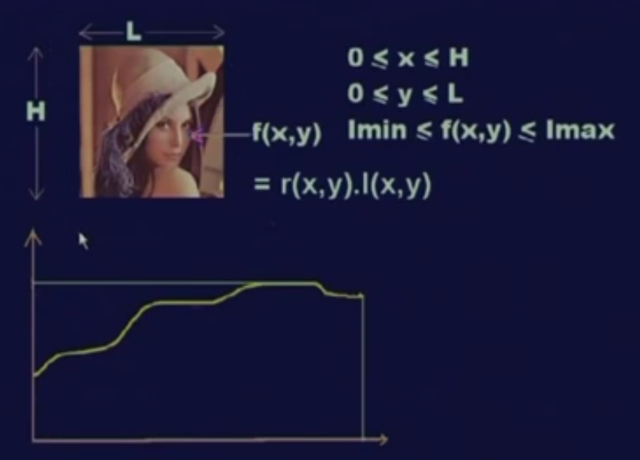
Why digitization we need?

Slide 5
Why digitization we need?
Theory of real numbers: between any two given points there are infinite numbers of points.
An image is represented by infinite number of points
Its not possible to represent infinite number in computer

Slide 6
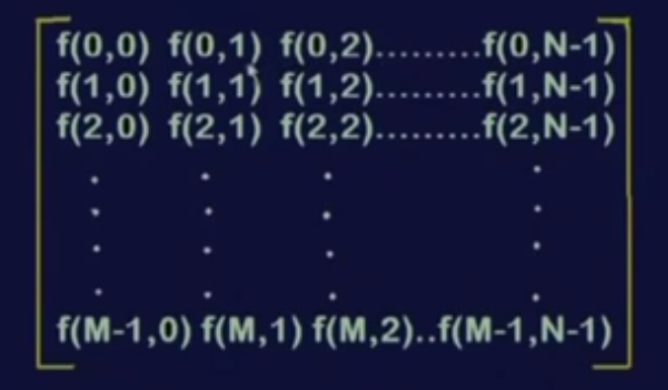
Digitization
1: An image shall be represented in a form of a finite 2D matrix
2: The element values of f should also be finite

Slide 7
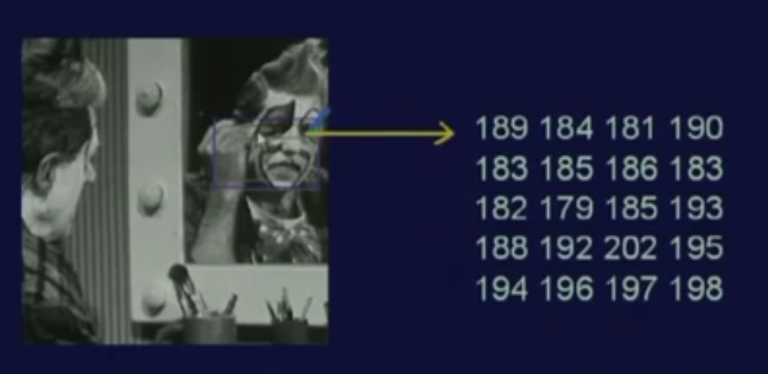
Image as a matrix of numbers representation

Slide 8
What is digitization ?
Image representation by D2 finite matrix (sampling)
Values of the Elements at the matrix are from the finite set of discrete values (quantization)

Slide 9
To process images we need
To digitize the image
Sampling (we will focus on it)
Quantization
To visualize the image it needs to for displaying the images, it has to be first converted into the analog signal which is then displayed on a normal display.

Slide 10
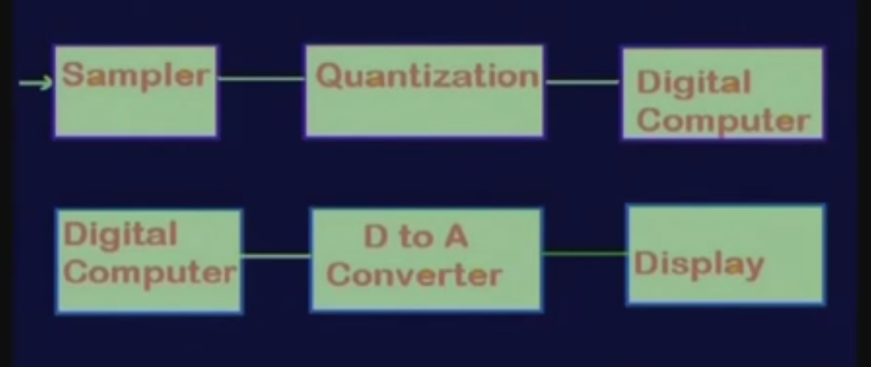
Sampling , Quantization and display

Slide 11
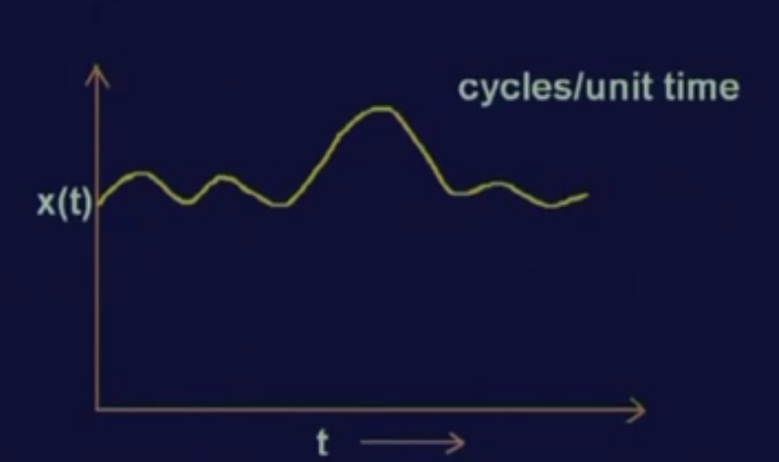
Sampling
1 D sampling
Assuming that we have a 1 dimensional signal x (t)
Which is a function of t.
Here, we assume this t to be time
It is known that whenever some signal is represented as a function of time; signal is represented in the form of hertz
Hertz means it is cycles per unit time.

Slide 12
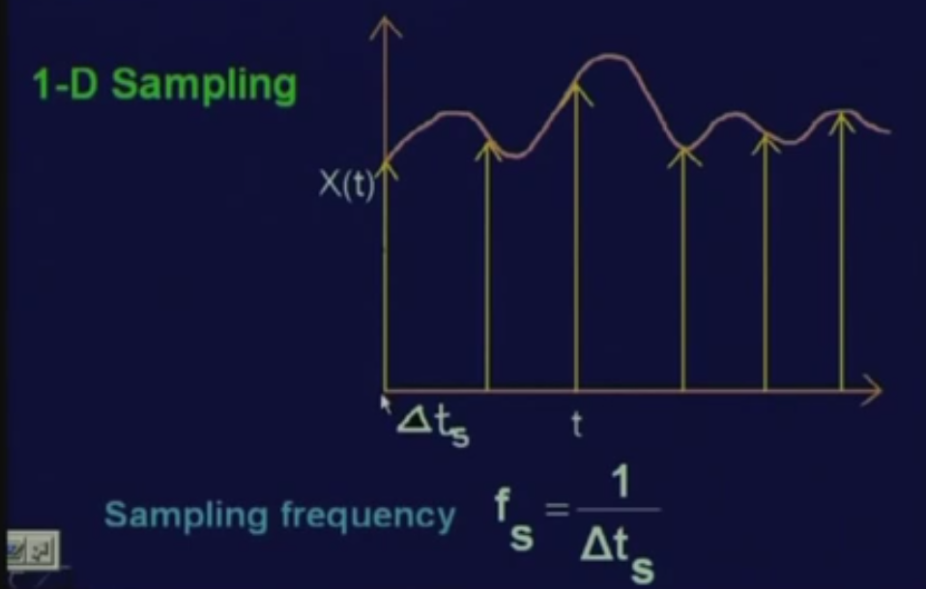
Sampling
Instead of taking considering the signal values at every possible value of t; consider the signal values at certain discrete values of t.
X (t) at t equal to 0.
the signal X (t) at t equal to 2 delta t S
The value of signal X (t) at t equal to delta 2 t S,
at t equal to delta 3 t S
and so on.
delta t S is the sampling interval and corresponding sampling frequency is represent it by f S, it becomes 1 upon delta t S.
Issue is local minimum, local maximum,

Slide 13
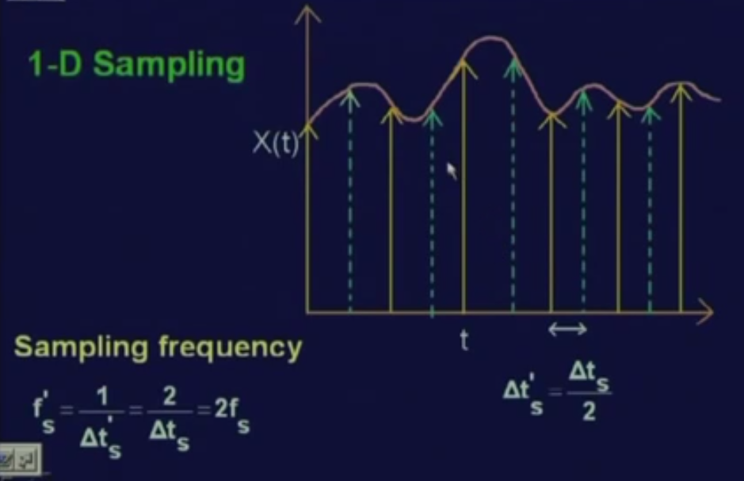
Sampling issue
increase the sampling frequency or decrease the sampling interval.
make the new sampling interval represented as delta t S dash which is equal to delta t S by 2.
The sampling frequency is f S dash equal to 1 upon delta t S dash, twice of f S.
The earlier sampling frequency of f S, and now its delta 2 f S, twice f S

Slide 14
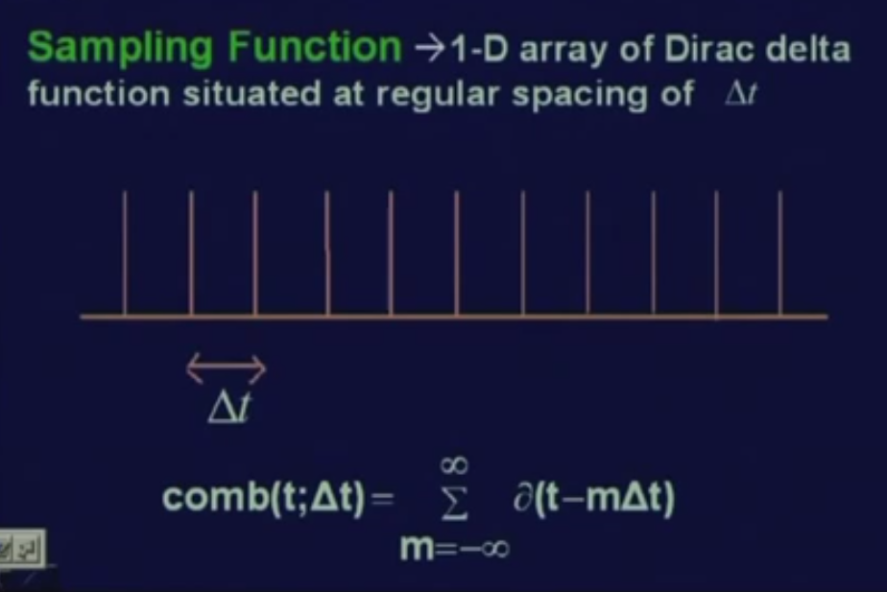
Theory of sampling
Each of these are sequences of Dirac delta functions and the spacing between 2 delta functions is delta t.
In short, these kind of function is represented by comb function, a comb function t at an interval of delta t and delta t minus m into delta t, where m varies from minus infinity to infinity.

Slide 15
Dirac delta function
Dirac delta function delta t, the functional value will be 1 whenever t equal to 0
the functional value will be 0 for all other values of t.
In this case, when delta t minus m of delta t, this functional value will be 1 only when this quantity that is (t minus m delta t) becomes equal to 0.
That means this functional value will assume a value 1 whenever t is equal to m times delta t for different values of m varying from minus infinity to infinity.

Slide 16
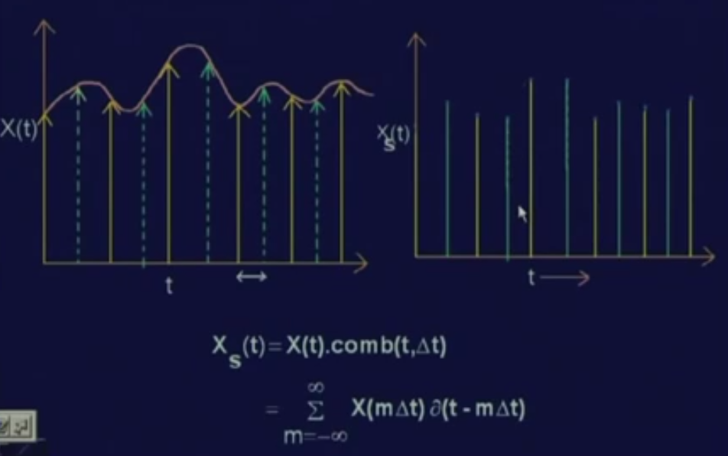
Theory of sampling
These samples can now be represented by multiplication of X (t) with the series of Dirac delta functions that we have seen that is comb of t delta t.
So by multiply, whenever this comb function gives a value 1; only the corresponding value of t will be retained in the product and
whenever this comb function gives you a value 0, the corresponding points, the corresponding values of X (t) will be said to 0.

Slide 17
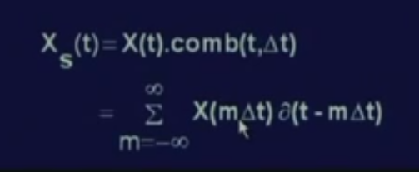
The discretization process can be represented mathematically as
x S (t) is equal to X (t) into comb of t delta t and
If expand the comb function and consider only the values of t where this comb function has a value 1, then this mathematical expression is translated to x of m delta t into delta t minus m delta t
where m varies from minus infinity to infinity.

Slide 18
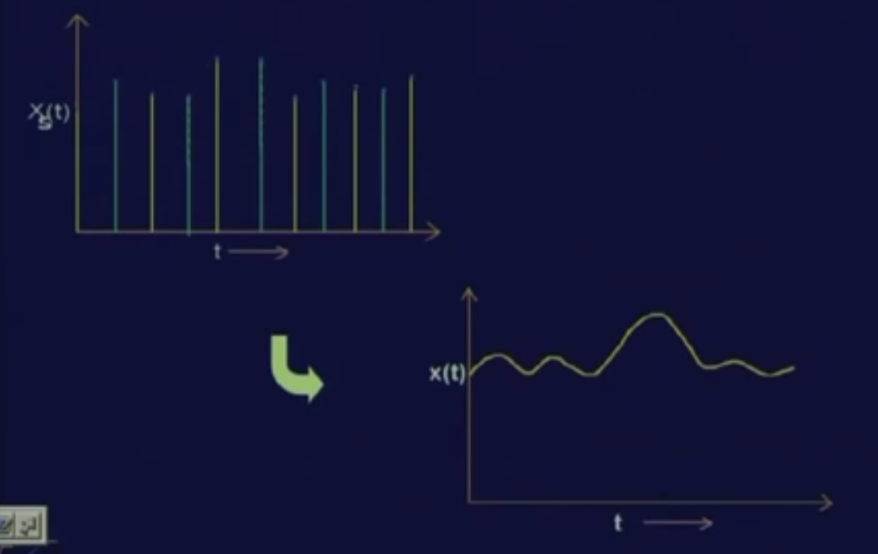
Sampling from signal
The sampling will be proper if its to be reconstruct the original continuous signal X (t) from these sampled values
For that needs to maintain certain conditions so that the reconstruction of the analog signal X (t) is possible.

Slide 27
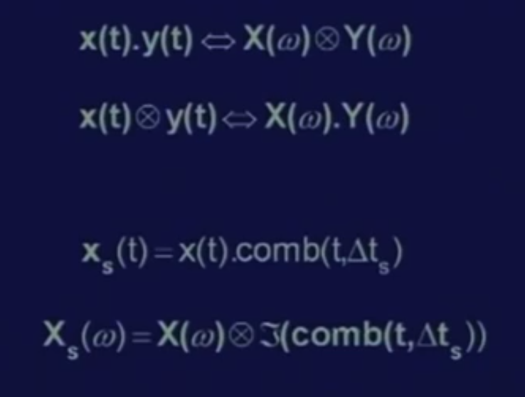
Reconstruction
In time domaine One signal is X (t), the other signal is comb function, comb of t delta t. So, these relations, as these are true that if multiply 2 signals X (t) and y (t) in time domain that is equivalents to convolution of the 2 signals x omega and y omega in the frequency domain.
For Sampling we have got x s (t) that is the sampled values of the signal X (t) which is nothing but multiplication of X (t) with the series of Dirac delta functions represented by comb of t delta t.
it is equivalent to in frequency domain, x S of omega which is equivalent to the frequency domain representation x omega of the signal X (t) convoluted with the frequency domain representation of the comb function, comb t delta t and
the comb function is the Fourier transform or the Fourier series expansion of this comb function which is again a comb function.

Slide 28
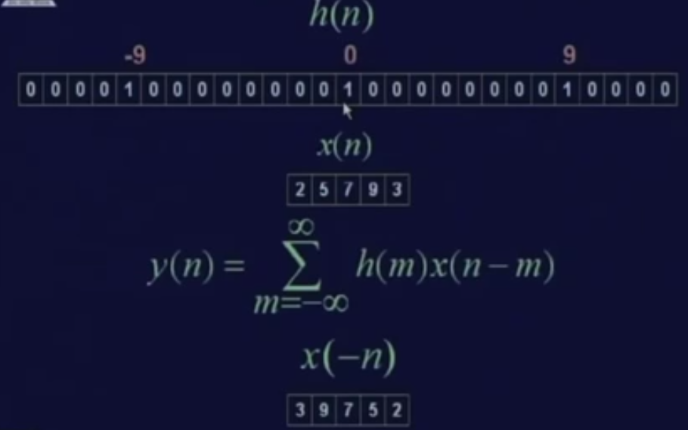
Convolution
2 signals h (n) and x (n) are in the sample domain.
h (n) is nothing but a comb function where the delta t S have value of h (n) is equal to 1 at n equal to 0, …
In discrete data domain, the convolution expression is translated to y (n) equal..
So, let us see that how this convolution actually takes place.

Slide 29
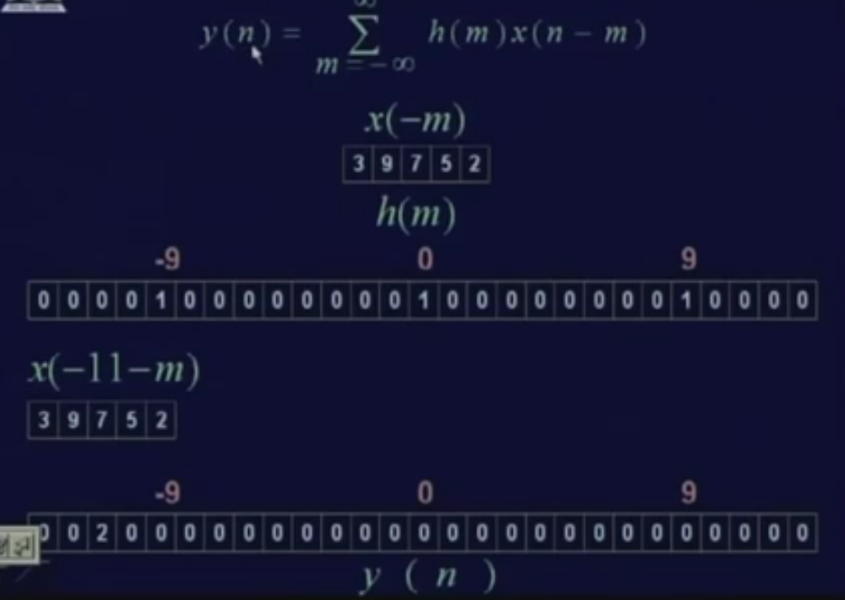

Slide 30
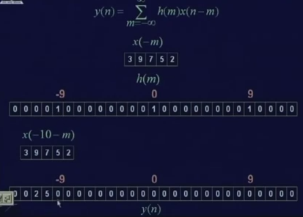

Slide 31
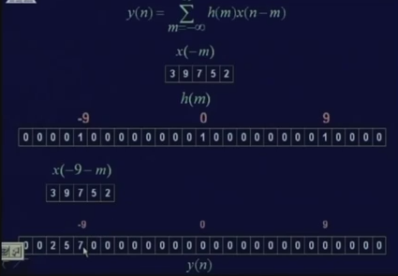

Slide 32
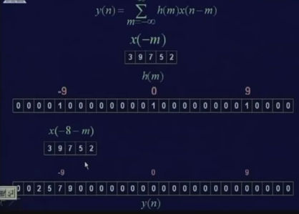

Slide 33
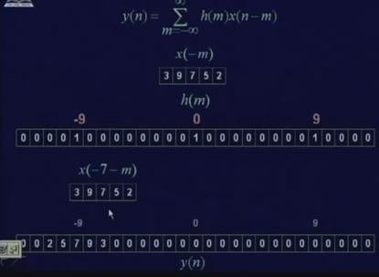

Slide 34
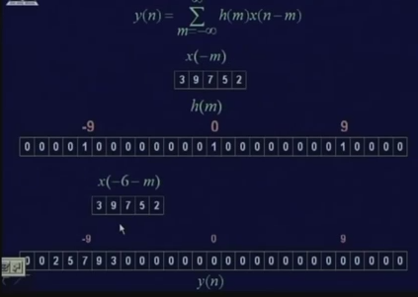

Slide 35
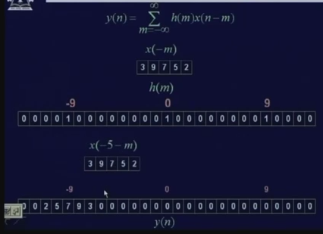

Slide 36
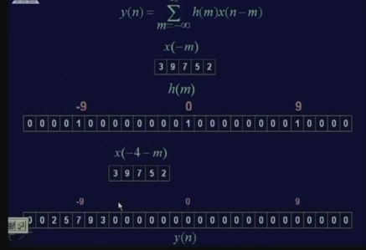

Slide 37
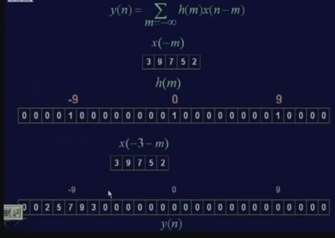

Slide 38
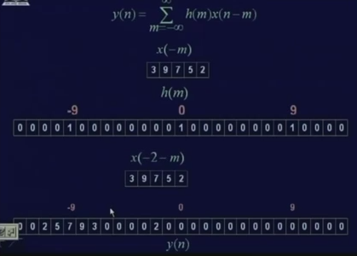

Slide 39
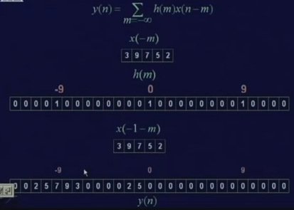

Slide 40
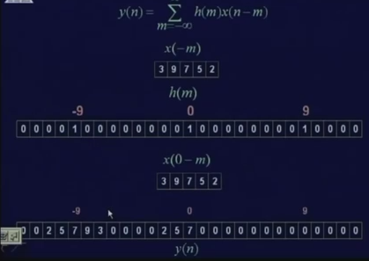

Slide 41
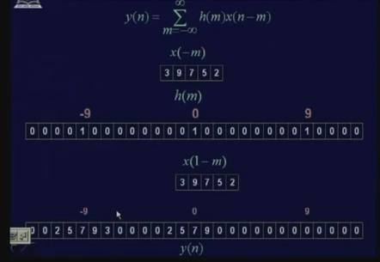

Slide 42
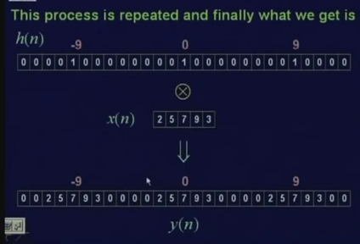

Slide 43
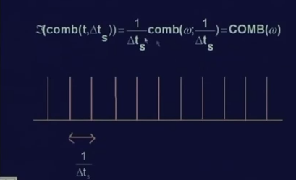
Convolute 2 signals X (t) and the Fourier transform of this comb function that is comb omega in the frequency domain

Slide 44
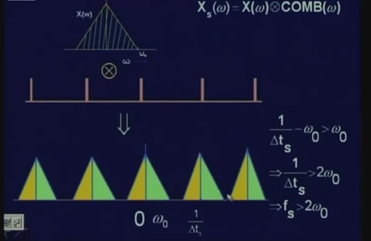
When X (t) is band limited, that means the maximum frequency component in the signal X (t) is omega naught; then the frequency spectrum of the signal X (t) which is represented by x omega
With low pass filter whose cut off frequency is just beyond omega naught and this frequency signal, will pass through low pass filter and will just take out this particular frequency band and it will cut out all other frequency bands.

Slide 45
The frequency gap between this frequency band and this translated frequency band are
The difference of between center of frequency band and the other center of frequency band is nothing but 1 upon t S which is equal to omega s that is the sampling frequency.
As long as this condition that is 1 upon t S minus omega naught is greater than omega naught, that is the lowest frequency of this translated frequency band is greater than the highest frequency of the original frequency band;
then only these 2 frequency bands are disjoint and when these 2 frequency bands are disjoint, then only by use of a low pass filter, I can take out this original frequency band.

Slide 46
References
Prof .P. K. Biswas Department of Electronics and Electrical Communication Engineering Indian Institute of Technology, Kharagpur
Gonzalez R. C. & Woods R.E. (2008). Digital Image Processing. Prentice Hall.
Forsyth, D. A. & Ponce, J. (2011).Computer Vision: A Modern Approach. Pearson Education.

